Slide 1
Gunnery Control Handle
Group 9: Senior Design
Deanna McKenzie Michael D. Brown William Thornton

Slide 2
Presentation Outline
Introduction
Mechanical System
Computer Interface
Prototype Design
Proposed Improvements

Slide 3
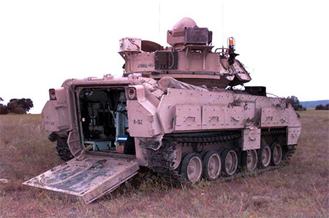
Intro: Background
Armored Vehicles
Very expensive pieces of equipment
Pilots cannot always be trained in the field
Need for simulators to help train drivers
There are MANY types of vehicles; hence MANY different simulators

Slide 4
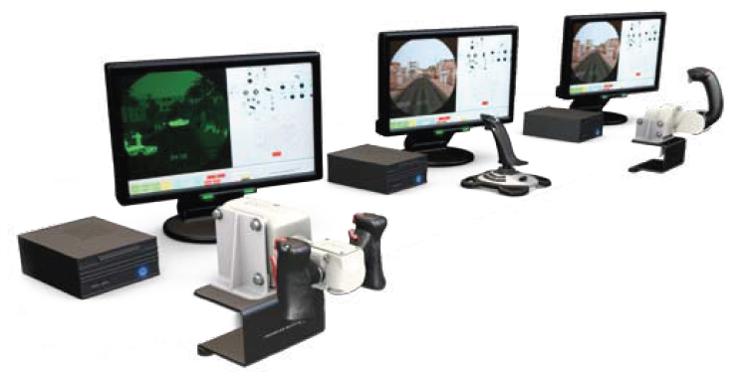
Intro: Project Scope
Design a generic simulator handle
Reduce Weight
Make handle interchangeable

Slide 5
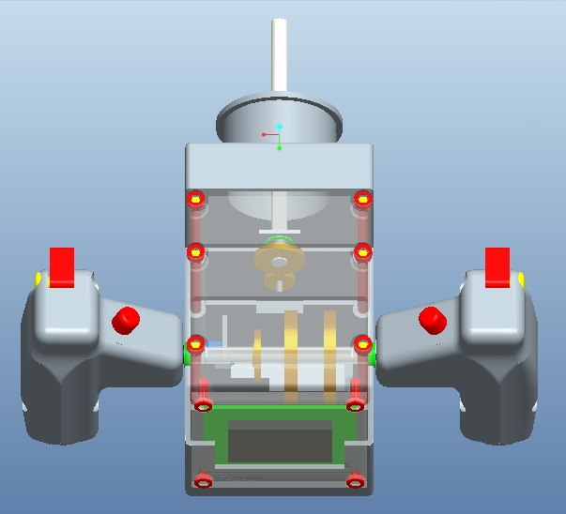
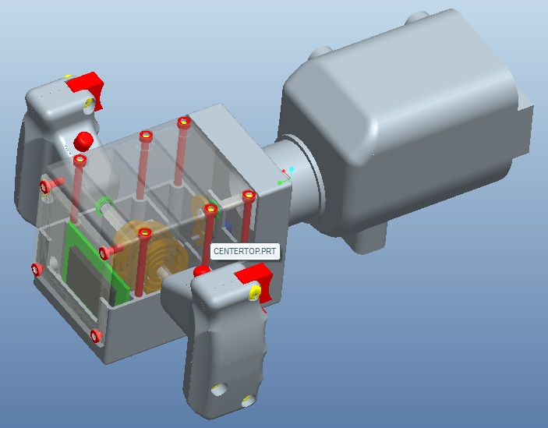
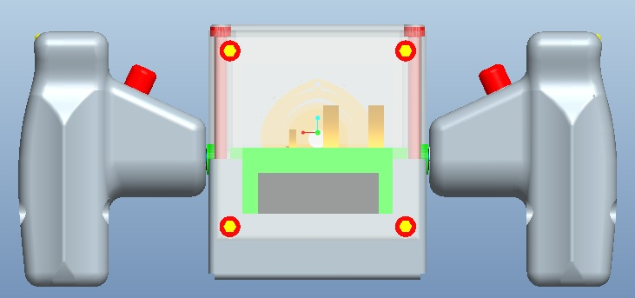
Mech: Pro/E Assembly

Slide 6
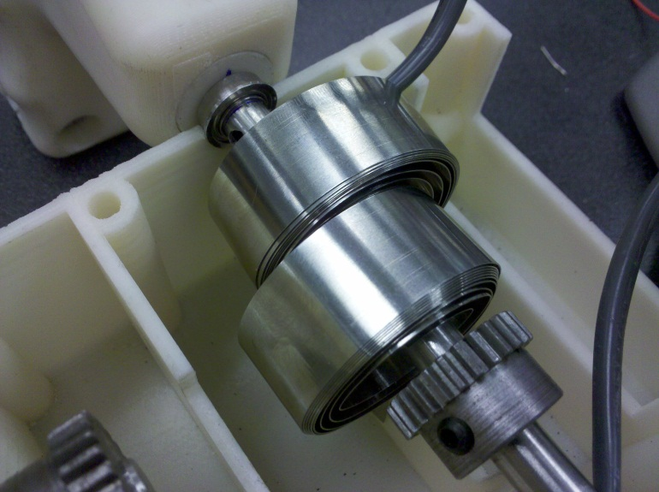
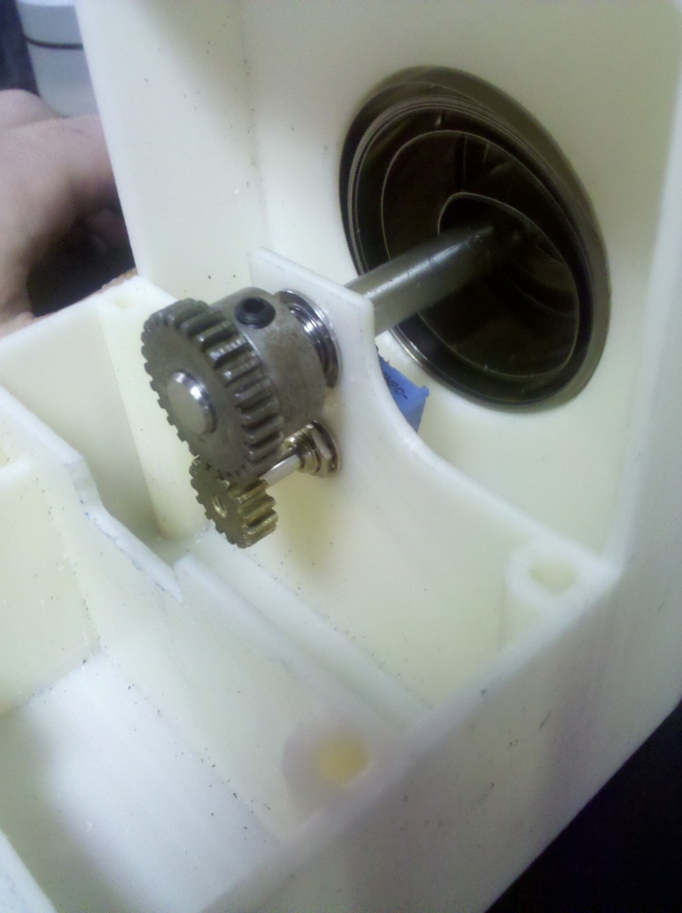
Mech: Torsion Springs
Counter-opposing
Constant torsion
Difficulty keeping equilibrium position
Recommend combination with cam system

Slide 7
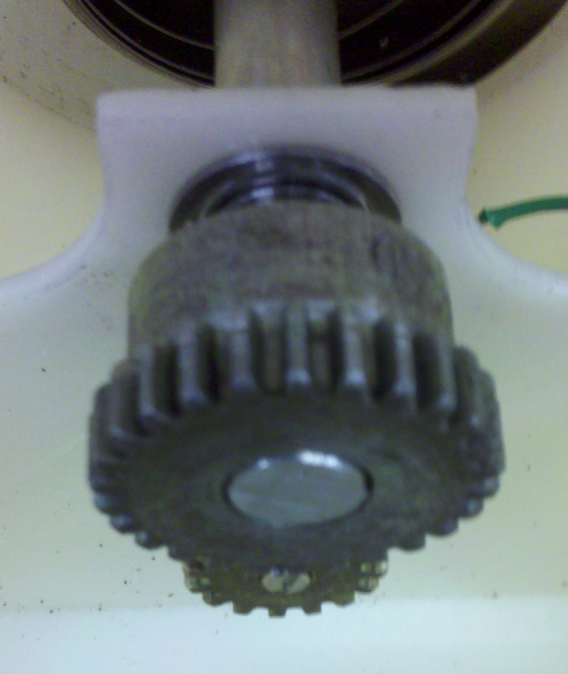
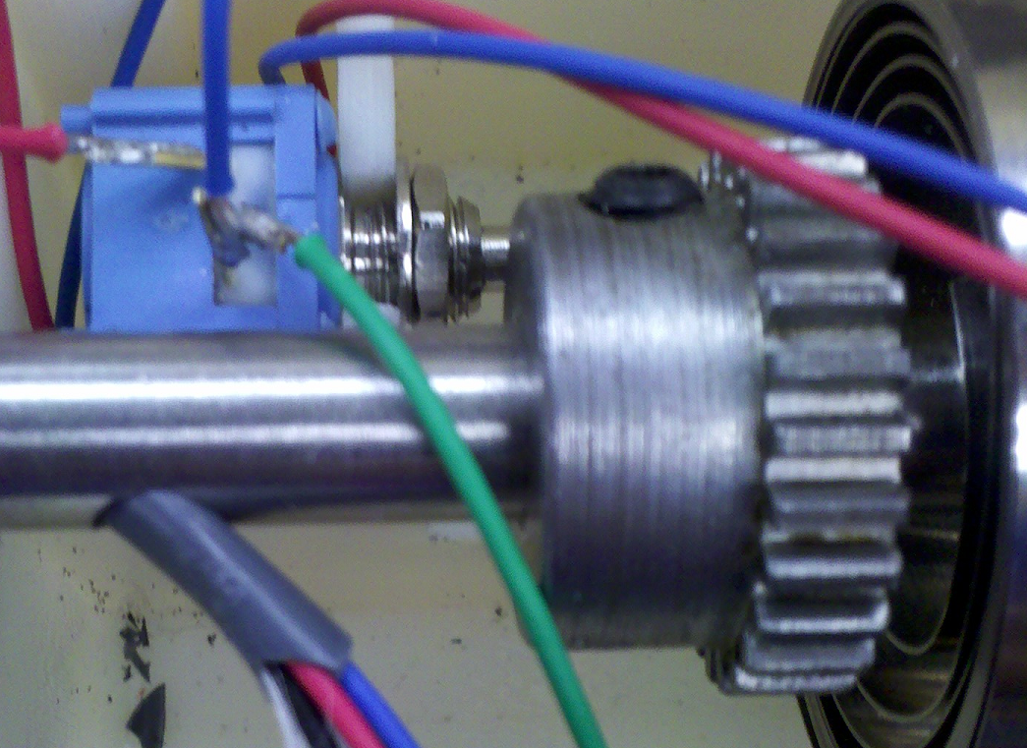
Mech: Gears and Potentiometers
Each shaft geared to potentiometer
Pots have large full angle (about 290˚)
Gearing gives shafts small full angle (about 150˚) while still utilizing full angle of pots

Slide 8
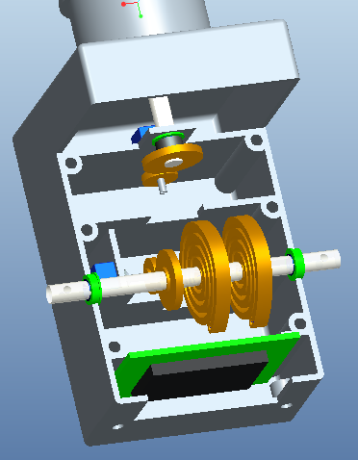
Center Body Layout
4 Bearings
2 Shafts
4 Gears
2 Potentiometers
4 Torsion Springs
1 Microcontroller

Slide 9
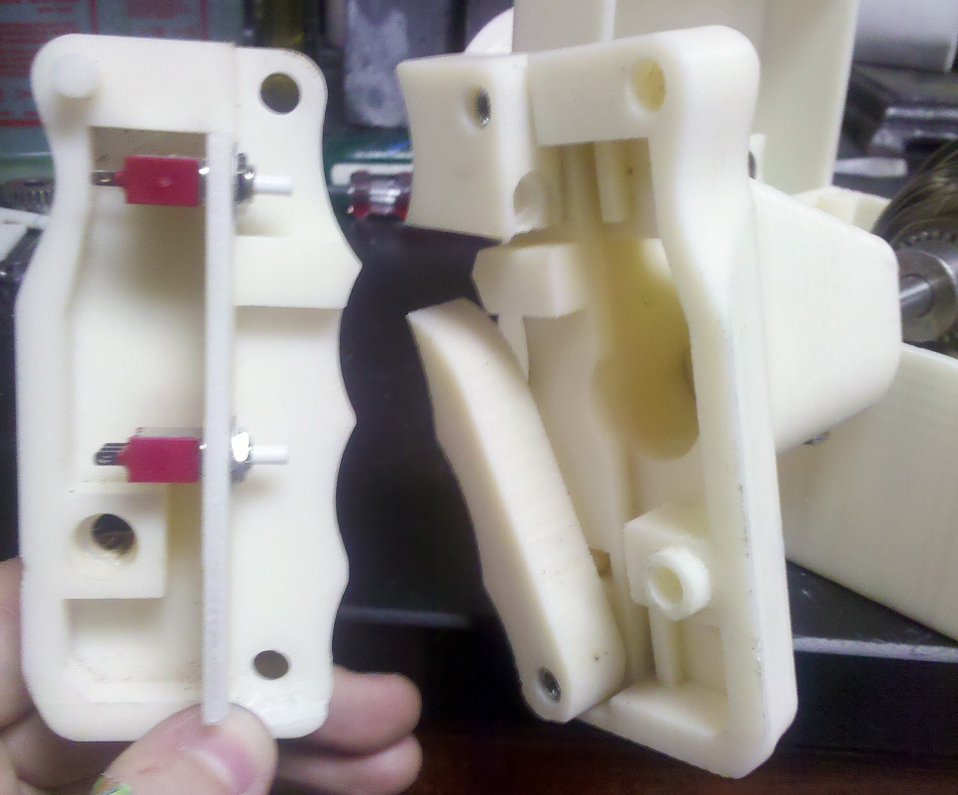
Mech: M1A Gunners Handle
2 Triggers
2 contact switches
1 button switch

Slide 10
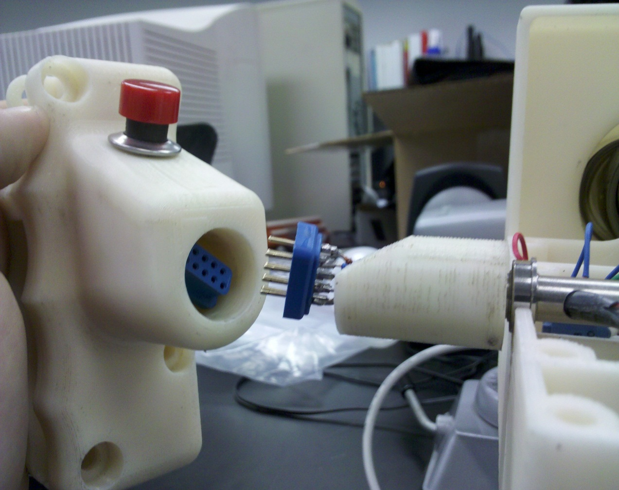
Mech: Handle Attachment
Wire Connections
Handle Connector

Slide 11
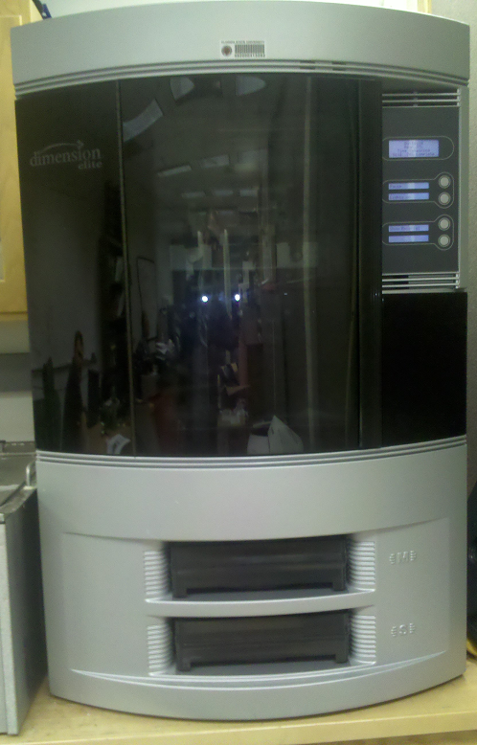
Rapid Prototype: Equipment
Can print models up to 10” x 10” x 12”
Prints with ABSplus thermoplastic
Production grade
Printed from bottom up
Soluble supports during printing
Allows for more complex modeling

Slide 12
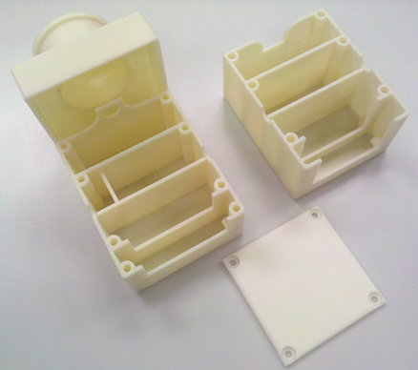
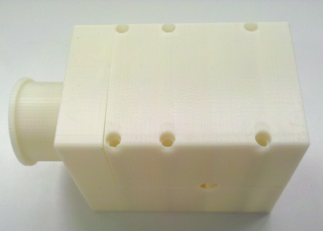
Rapid Prototype: Center Body
Material is layered ABS plastic
Weaker than injection molded ABS
Yields quicker along print planes
Only to be used as prototype

Slide 13
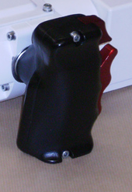
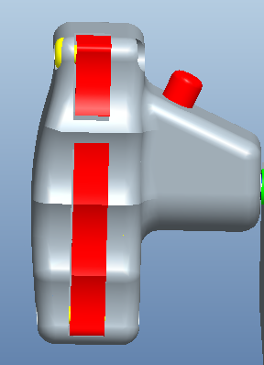
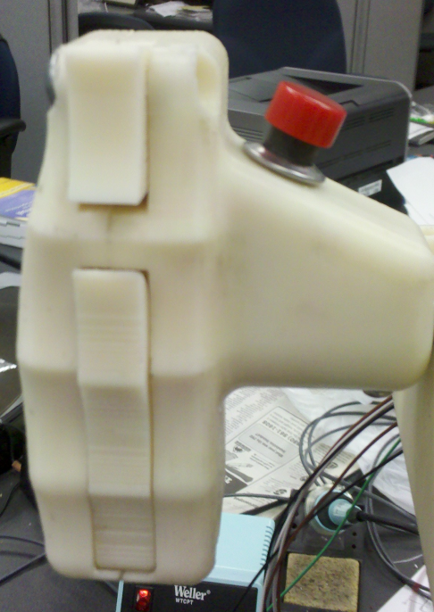
Rapid Prototype: M1A Gunners Handle
http://www.armedforces-int.com/suppliers/afv-sim-ltd.html
Handle design in Pro/E
Produced from first hand experience and assorted pictures online
Final Handle
ABS printed plastic
2 triggers (2 switches)
1 button switch
Original handle
No measurements
No pictures

Slide 14
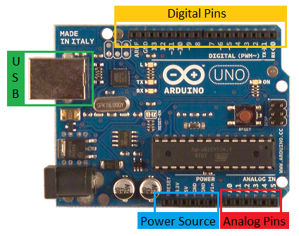
Microcontroller
Arduino Uno Microcontroller
Open source
Thirteen digital pins plus ground pin
6 analog to digital converters
6 power source options
USB connectivity/power
Can be powered by adapter, USB or battery

Slide 15
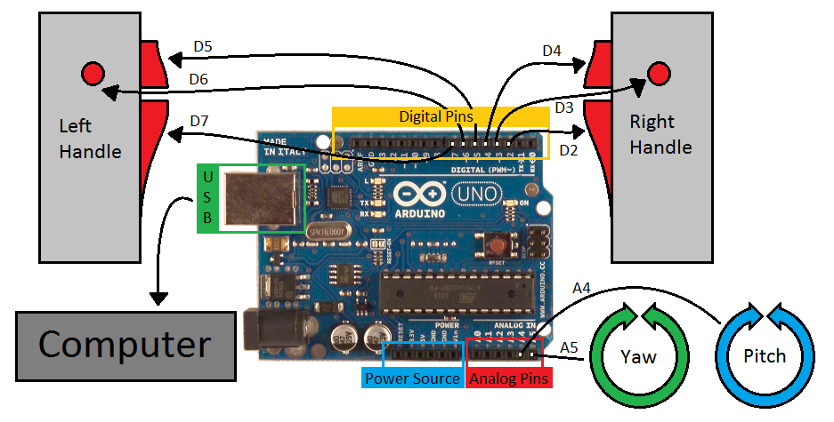
Microcontroller: Schematic

Slide 16
330Ω
330Ω
330Ω
330Ω
330Ω
330Ω
left handle
6 wires
6 wires
right handle
3 wires
3 wires

Slide 17
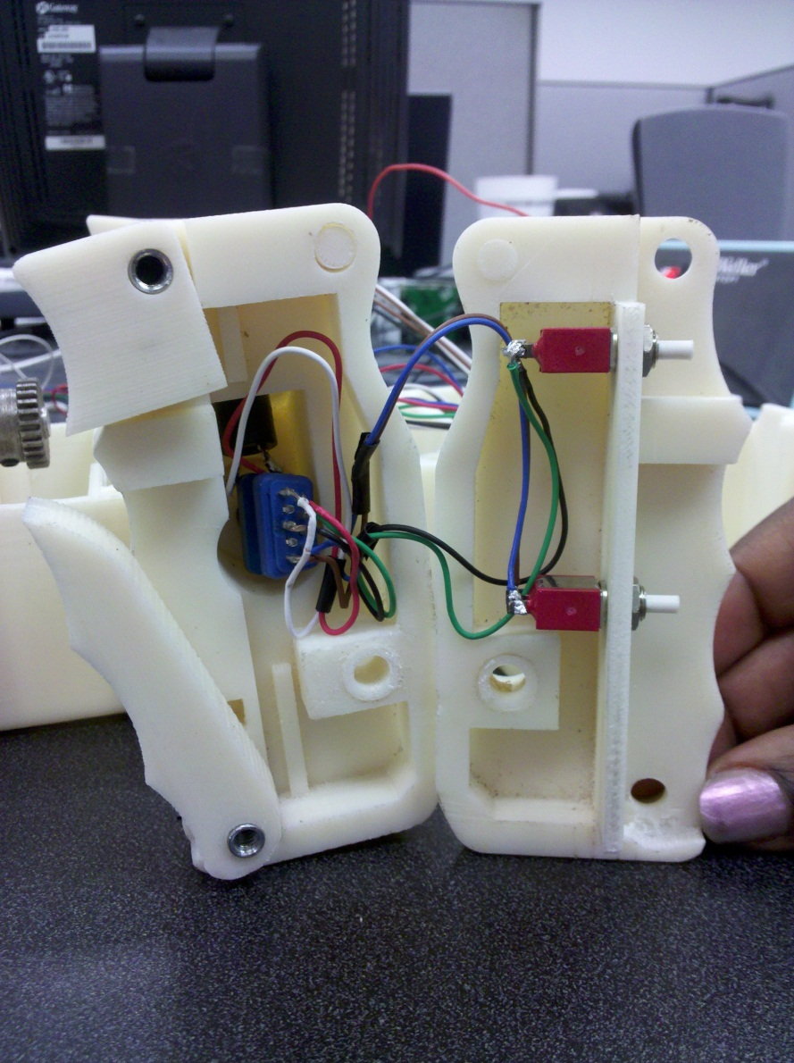
Handle Wiring
Wiring moves from the connector to switches inside the handle.
Connector allows for detachable handles

Slide 18
Prototype: Key Problems and Solutions
Problems
Solutions
Accessibility to center shaft springs is inadequate.
Handles will not always return to equilibrium
Difficulty wiring system
Layered ABS is weak along plastic planes
Allow for access through front of center body
Use torsions springs as well as cam system
Design for wiring pathways within body
Fabricate using injection molded ABS

Slide 19
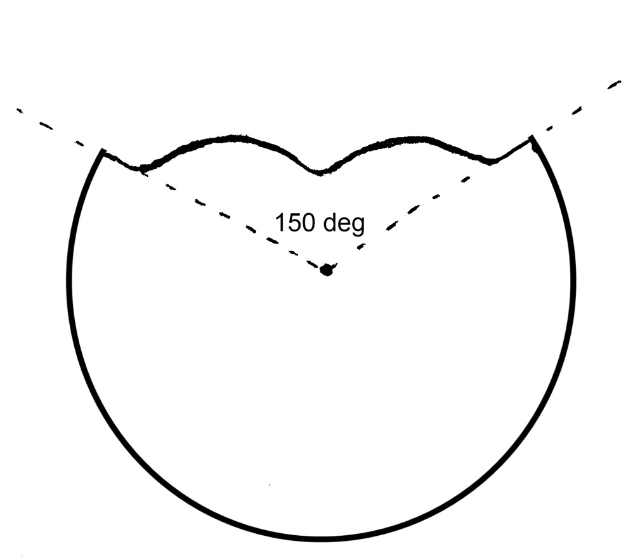
Prototype: Cam System Proposal
All aspects of handles can be controlled by different cams
Cam defines equilibrium for each handle
Cams can be lined up next to one another for easy switching between handles

Slide 20
Cost Analysis
Part | Quantity | Pr ice ($) | Total Cost ($)
Shaft | 1 | 20.25 | 20.25
Bearings | 4 | 8.72 | 34.88
Microcontroller | 1 | 29.95 | 29.95
Potentiometers | 2 | 6.35 | 12.70
Pinion Gear | 2 | 13.05 | 26.10
Gear | 2 | 13.56 | 27.12
6-cond. Wire | 15 ft | 0.31/ft | 4.65
4-cond. wire | 15 ft | 0.37/ft | 5.55
Torsion Springs | 8 | 7.88 | 63.04
Buttons | 6 | 6.95 | 41.70
Total $265.94

Slide 21
Acknowledgements
Lockheed Martin; Client
Steve Preston; Client Contact
Jeff Payne; Client Contact
Ernie Morrow; General Dynamics Contact
Dr. Rob Hovsapian; Senior Design Professor
Dr. Jonathan Clark; Faculty Advisor

Slide 22
Questions?

